Slide 1


University of Salerno – Department of Computer Science
PRESENTATION
SCIoT Project:
Tyre Pressure Detection System
Student:
Michele Delli Paoli
Notes:
Good afternoon professor and good morning Giuseppe.
This is Michele Delli Paoli, and I’m here to present you my project, named: Tyre Pressure Detection System

Slide 2
INDEX
Table of contents
• Tyre pressure detection
• Low tyre pressure causes
• State of the art
• Previous generation
• Scenario
• Psychological aspects
• Security
• Knowledge
• Knowledge benefits
• Application goal
• Market share
• Architecture
• Functions
• Why Serverless?
• Technologies
• Live Demo
Notes:
Moving on, this is the table of the contents we will go through.

Slide 3
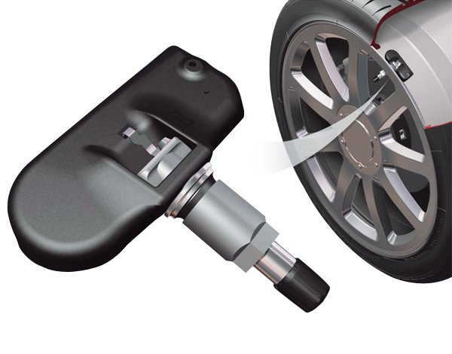
TYRE PRESSURE
Tyre pressure detection
Tyre pressure detection is provided by sensors installed on the tyre.
• average tyre pressure: 32 – 35 psi
• Psi: Pound per square inch
• 1 psi = 6895 Pa
When the tyre pressure goes below 32 psi,
the driver is usually reported to have low tyre pressure.
Notes:
Let’s start by defining the process of tyre pressure detection.
It is provided by sensors installed on the tyre.
The average tyre pressure ranges from 32 to 35 psi.
Psi stands for «pound per square inch».
1 psi corresponds to sixty eight - ninty five Pascal.
[Premi freccia Giu]
When the tyre pressure goes below 32 psi,
the driver is usually reported to have low tyre pressure.

Slide 4

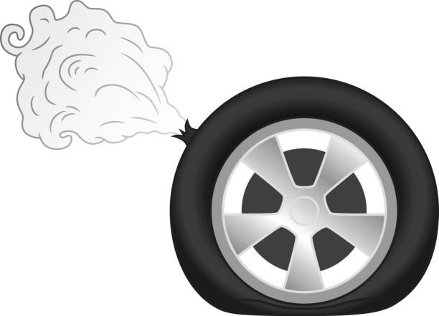
CAUSES
Low tyre pressure causes
The main causes:
• cold temperatures
• tyre puncture
Cold temperatures cause tyre air to lose density.
It is particularly relevant during the colder months of the year.
Having a low tyre presure is not necessarily a problem.
A tyre puncture is dangerous!
It may compromise the drivability and stability of the car.
Notes:
But what are the causes of Low Tyre Pressure?
The main causes are 2: «cold temperatures» and «tyre puncture».
[Premi freccia giu]
Cold temperatures bring tyre air to lose density.
This happens often during the colder months of the year.
Having a low tyre presure is not necessarily a problem.
[Premi freccia giu]
Instead, having a tyre puncture is dangerous!
It may compromise the drivability and stability of the car, causing incidents.

Slide 5
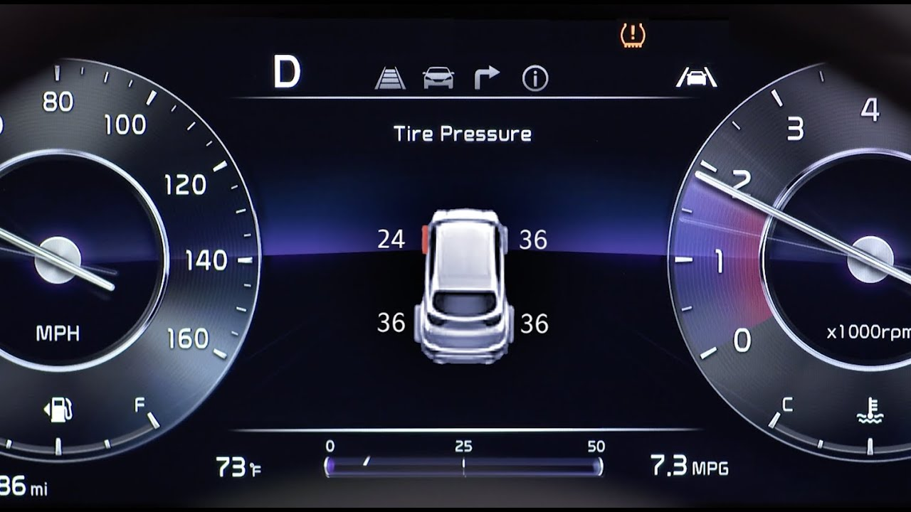
STATE OF THE ART
State of the art
The latest generation’s cars are very smart.
They have many sensors to monitor: road, other cars, pedestrians, external temperature, etc.
Some of these sensors are used to monitor the tyre pressure.
On the main console, these cars provide a complete picture of the tyre pressure condition.
The driver can observe the tyre pressure values in order to detect himself a tyre puncture.
It is characterized by a continuous drop in tyre pressure values.
Notes:
What is the State of the Art of modern Tyre Pressure Detection systems?
The latest generation’s cars are really SMART.
They have many sensors to monitor: road, other cars, pedestrians, external temperature, etc.
Some of these sensors are used to monitor the tyre pressure.
[Premi freccia giu]
On the main console, these cars provide a complete picture of the tyre pressure condition.
So, the driver can observe the tyre pressure values reported by the console, in order to detect himself a tyre puncture, since it is characterized by a continous drop in these values.

Slide 6
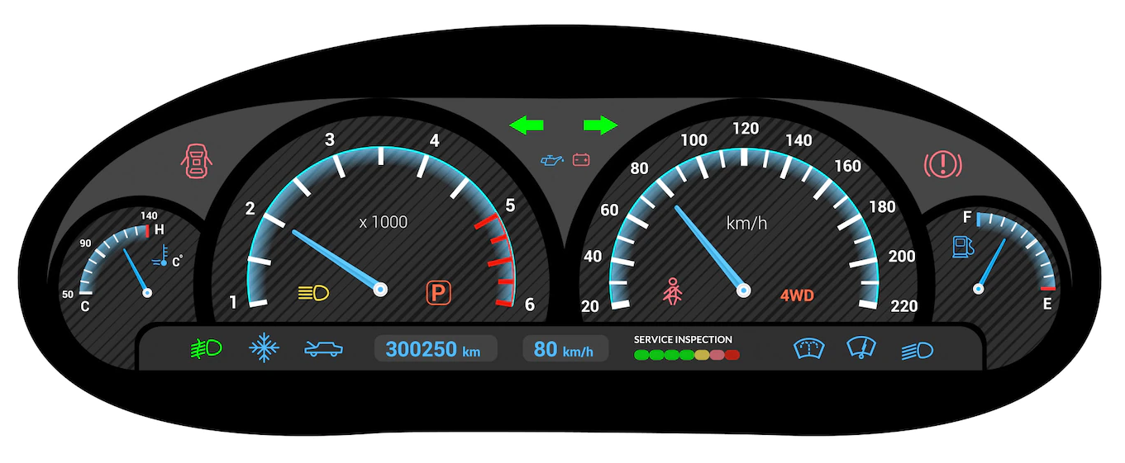
PREVIOUS GENERATION
Previous generation
Unfortunately, previous generation cars do not provide the same amount of informations.
They may report:
• incomplete information regarding the tyre pressure;
• no information at all.
Notes:
Unfortunately, previous generation cars do not provide the same amount of informations.
In fact, they may report:
• incomplete information regarding the tyre pressure;
• no information at all (for instance, think about all those cars who still have an analogical console)

Slide 7

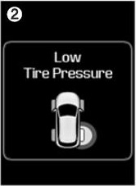
SCENARIO
Scenario
Let's suppose to be on a road trip.
Suddenly, the car console shows an indicator on.
The indicator says: "Low Tire Pressure".
Unfortunately, such indicator reports us an incomplete information.
The driver is unaware if:
• a tyre puncture has occured;
• it is just a small drop in tyre pressure.
Notes:
Now, let’s suppose to be on a road trip, driving a car of the previous generation.
[Premi freccia giu]
Suddenly, the console shows an indicator on.
The indicator actually says: "Low Tire Pressure".
Unfortunately, such indicator reports us an incomplete information.
In fact, the driver is unaware if:
• a tyre puncture has occured;
• it is just a small drop in tyre pressure.

Slide 8
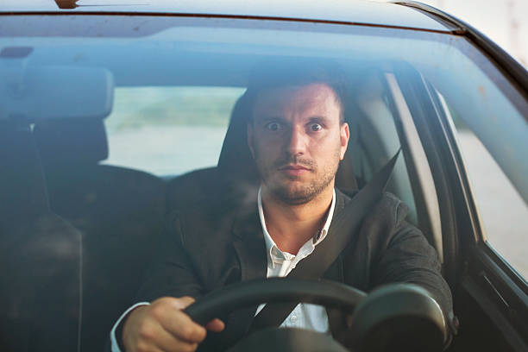
PSYCHOLOGY
Psychological aspects
Having incomplete information while driving is dangerous.
The driver starts thinking about the meaning of the indicator.
It could be either:
• a simple low tyre pressure alert
• a tyre puncture.
He starts feeling unsafe and uncomfortable while driving.
Notes:
In this case, there are some psychological aspects to take into account.
In fact, having incomplete information while driving is dangerous.
The driver starts thinking about the meaning of the indicator.
It could be either:
• a simple low tyre pressure alert
• a puncture alert.
[Premi freccia giu]
So, he starts feeling unsafe and uncomfortable while driving.

Slide 9

SAFETY
Safety
While driving, security comes first.
Furthermore, being comfortable while driving is crucial as well.
The driver must not have any worrying, but must focus on driving and on the road.
Feeling safe is safety itself!
Notes:
As we know, security comes first while driving.
Furthermore, being comfortable while driving is crucial as well.
The driver must not have any worrying, but must focus on driving and on the road.
[Premi freccia giu]
So, Feeling safe is safety itself!

Slide 10

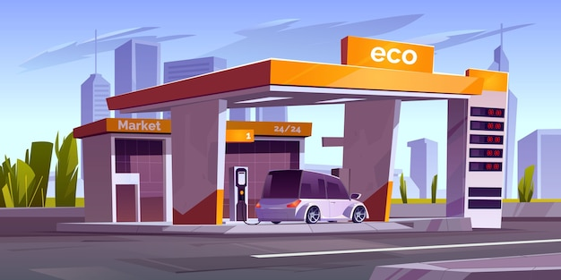
KNOWLEDGE
Knowledge
Because of the psychological aspects, in some cases, incomplete information is worst than
no information at all.
Knowledge is crucial.
If the driver knows that the tyre pressure is actually low, he can keep going.
Anyway, it is always recommended to stop to a service area, inflate the tyre, and back to travel again.
Otherwise, if he is reported that a tyre puncture occurs, he knows that he can't keep going.
He must stop to a mechanic as soon as possible to repair the puncture.
Notes:
Now, considering these psychological aspects, we can state that, sometimes, incomplete information is worst than no information at all.
[Premi freccia giu]
So, Knowledge is crucial.
[Premi freccia giu]
In fact, If the driver knows that the tyre pressure is actually low, he can keep going.
Anyway, it is always recommended to stop to a service area, inflate the tyre, and back to travel again.
[Premi freccia giu]
Otherwise, if the driver is reported that a tyre puncture occurs, he knows that he can't keep going.
So, he must stop to a mechanic as soon as possible to repair the puncture.

Slide 11


BENEFITS
Knowledge benefits
If the driver is in a hurry, knowing if he can keep going or must stop is time and cost saving.
Knowledge benefits:
• no time wasting at the tyre repairer
• no unnecessary billing by the tyre repairer
• daily schedule is safe!
Notes:
Anyway, if the driver is in a hurry, knowing if he can keep going driving or must stop is time and cost saving.
[Premi freccia giu]
So, in this scenario, knowledge brings the following benefits:
• no time wasting at the tyre repairer
• no unnecessary billing by the tyre repairer
• and the daily schedule is safe!

Slide 12
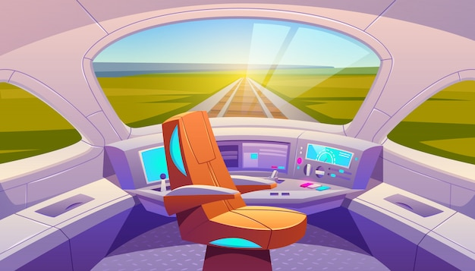
GOAL
Application goal
The developed system allows to monitor the pressure of a car's tyre in order to alert the driver:
• in case a tyre puncture occurs;
• just to report low tyre pressure.
It provides an enhanced console message system:
• Optimal tyre pressure.
• Low tyre pressure registered!
• Warning, possible tyre puncture!
• Tyre pressure restored!
Notes:
So, what it the goal of the system delevoped?
It allows to monitor the pressure of a car's tyre in order to alert the driver:
• in case a tyre puncture occurs;
• just to report low tyre pressure.
[Premi freccia giu]
It do so, by providing an enhanced console message system.
In fact, it shows the following messages on the console:
• Optimal tyre pressure.
• Low tyre pressure registered!
• Warning, possible tyre puncture!
• Tyre pressure restored!

Slide 13
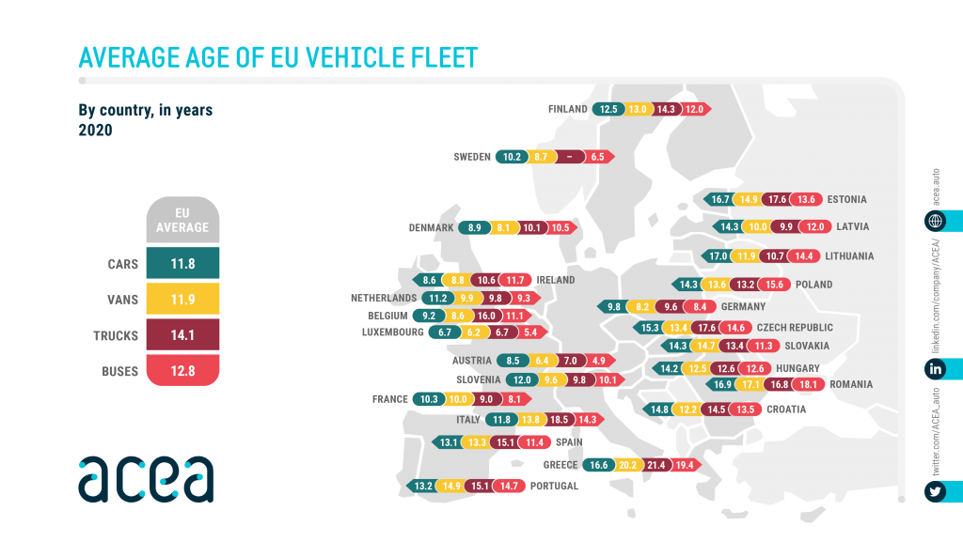
MARKETING
Market Share
Who is it oriented to?
The system is oriented to car owners who:
• have an incomplete tyre pressure detection system
• do not have any tyre pressure detection system at all *properly supported by hardware and sensors installation.
ACEA report that the average car age is:
• 11.8 years in Europe
These cars could fall all into the previous generation.
*source: https://www.acea.auto/figure/average-age-of-eu-vehicle-fleet-by-country/
Notes:
But who is this system oriented to?
It is oriented to car owners who:
• have a tyre pressure detection system which provides incomplete informations
• do not have any tyre pressure detection system at all.
[Premi freccia giu]
In fact, the European Automobile Manufacturer’s Association (ACEA) report that the average car age is:
• 11.8 years in Europe
These cars fall all into the previous generation.

Slide 14
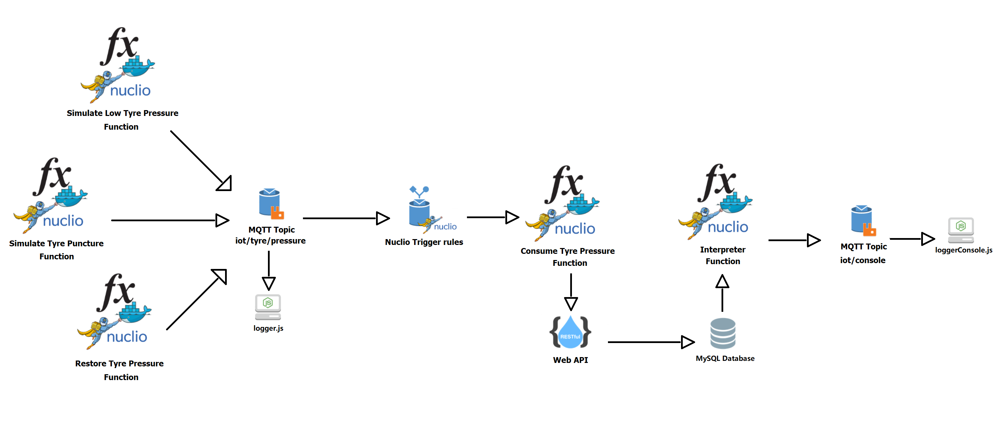
ARCHITECTURE
Architecture
The system is composed by:
• several functions in Node.js
• two loggers to print the console messages
• a MySQL Database
Notes:
The architecture of the system is very simple:
It is composed by:
Several functions written in Node.js.
two loggers to print the console messages.
And a MySQL Database to store the data.
Specifically, the Database is composed by a single Table and each record has 3 attributes: id, pressure, timestamp.
The decision to use a Relational Database is motivated by the SQL querying functionalities useful to sort and interpret the data.

Slide 15
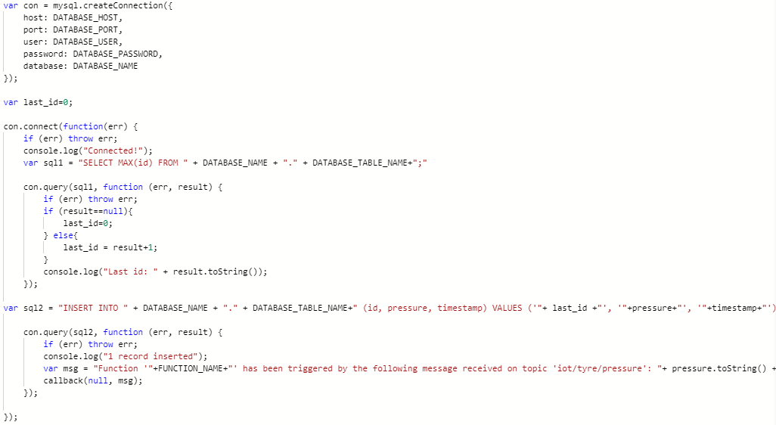
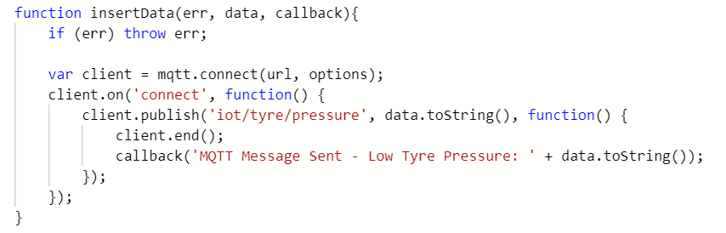
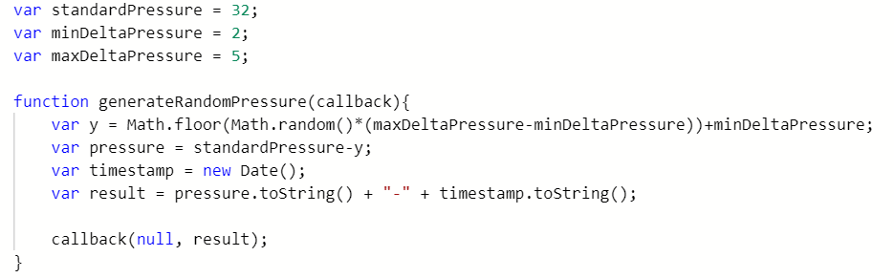
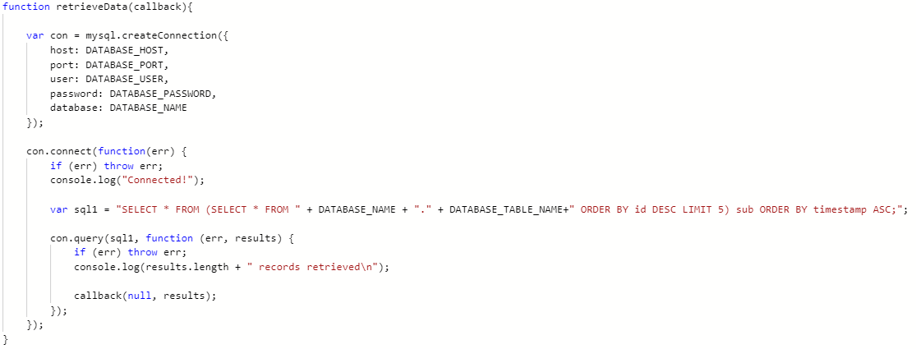
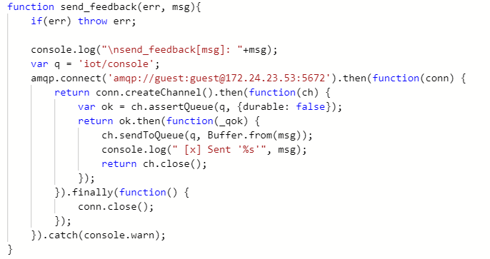
FUNCTIONS
Functions
They allow to:
• simulate the sensor detection by generating a random pressure value
• send these generated pressure values to the “iot/tyre/pressure” topic
• consume the incoming messages on the topic and insert data into the Database
• query data from the Database to interpret them
• report a message on the driver console.
Notes:
These functions allow to:
Simulate the sensor detection by generating a random pressure value
Send these generated pressure values to the “iot/tyre/pressure” topic
Consume the incoming messages on the topic and insert data into the Database
Query data from the Database to interpret them
Report a message to the driver console.

Slide 16


SERVERLESS
Why Serverless?
The application is deployed in a serverless way.
From the point of view of the SaaS provider, using Serverless has two benefits:
• cost-effectiveness: when the car is turned off, sensors do not record any data and no function runs.
• no need to manage and scale servers.
Notes:
The application is deployed in a Serverless way.
Why this?
From the point of view of the SaaS provider, using Serverless has two benefits:
[Premi freccia giu]
The first one is cost-effectiveness: when the car is turned off, sensors do not record any data and no function runs.
This way, no costs are billed respect to a server-based solution.
[Premi freccia giu]
Moreover, there is no need to manage and scale servers.

Slide 17





TECHNOLOGIES
Technologies
To run the system, it is necessary to install the following software components:
• Docker
• Node.js
• Nuclio
• RabbitMQ
• MySQL
Notes:
The system relies on the following software components:
Docker: it is a Containerization platform which allows you to package, deploy and run portable applications with ease.
Node.js: it is a JavaScript runtime useful to execute back-end code.
Nuclio: it provides Serverless functionalities by enabling you to run a function when an event is triggered. It is executed on a Docker Container.
RabbitMQ: it is a message broker useful to post messages on topics, by using either MQTT or AMQP protocol. It is executed on a Docker Container.
MySQL: it provides a Relational Database instance in which we will store our recorded pressure values with their relative timestamp, in order to gather and process them. It is executed on a Docker Container.

Slide 18

LIVE DEMO
Live Demo
Let’s run the system!
You can always find all the information regarding the project to GitHub:
https://github.com/micheledellipaoli/TyrePressureDetection
Notes:
Now, let’s run the system!
Anyway, you can always find all the information regarding the project to this GitHub repository.

Slide 19

CONCLUSIONS
Thanks for the attention!

